Slide 1

Project Title: Behavioral Finance Patterns in Predicting Global Financial Crises: An Analytical Approach to Crisis Forecasting
Domain: Economics & Finance
Zeroth Review
Register Number: 23MSP3068
Name: Dharshani A.
Date: 16-11-2023
Course Code: CS6510
Course Title: Project 1

Slide 2
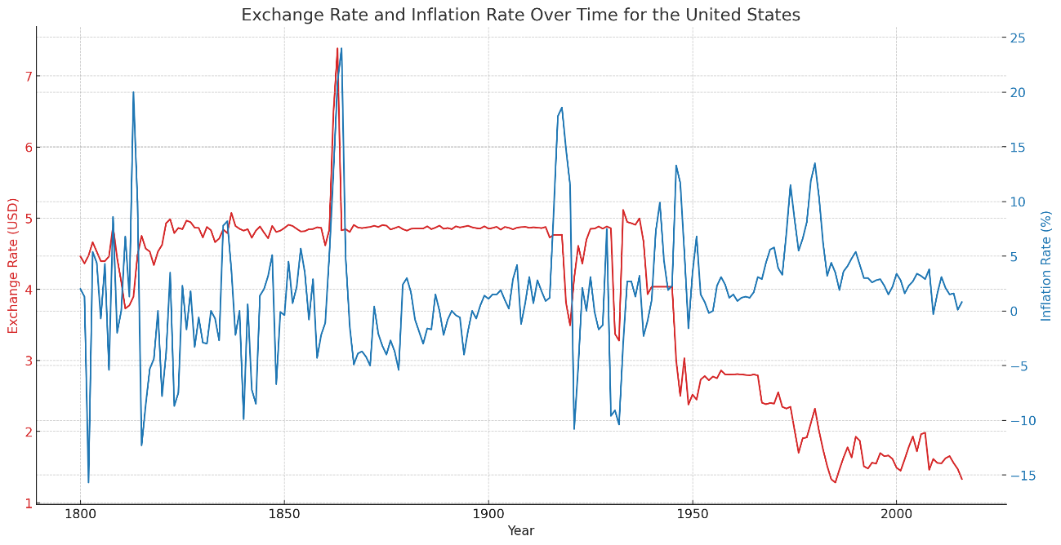
Problem Statement
Aim:
To develop a predictive model based on
historical data from the global financial
crisis, incorporating key economic
indicators, market trends, and financial
metrics.
Need for Research:
To maintain vigilance in the financial sector and among policymakers and investors regarding the anticipation and mitigation of future financial downturns.
To identify early warning signals and patterns that historically precede financial crises, offering a proactive approach to economic stability.
To analyze the changes in economic indicators leading up to the 2007-2008 crisis, with the goal of forecasting future financial downturns.
To enable stakeholders to take preemptive measures to protect the global economy by predicting potential crises.

Slide 3
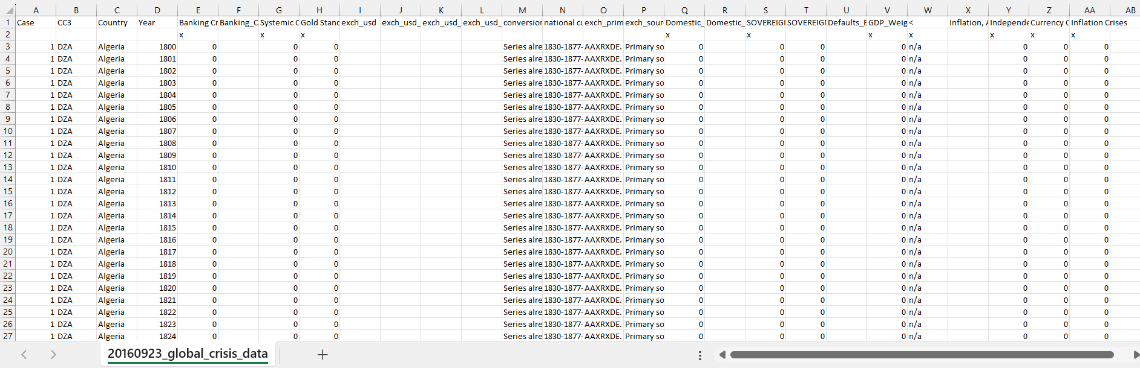
Dataset
Source of the Dataset: Global Financial Crisis Analytics | Kaggle
No. of Observations: 15,192
Screenshot of the dataset

Slide 4
Column/Feature Details of the Dataset
1. Case: A numeric identifier for each record. Each country appears to have a unique case number.
2. CC3: The three-letter country code, following the standard ISO alpha-3 country codes.
3. Country: The name of the country to which the data row corresponds.
4. Year: The year for which the data is recorded.
5. Banking Crisis: Indicates the occurrence of a banking crisis. '0' indicates no crisis, while '1’ indicates a crisis.
6. Banking_Crisis_Notes: Additional notes or explanations about the banking crisis, if any.
7. Systemic Crisis: Indicates whether a systemic crisis occurred in that year. Similar to 'Banking Crisis', '0' likely means no systemic crisis.
8. Gold Standard: Indicates whether the country was on the gold standard in that year.
9. exch_usd: The exchange rate of the country's currency to the US dollar.
10. exch_usd_alt1, exch_usd_alt2, exch_usd_alt3: Alternative exchange rate values, representing different sources or calculation methods.
11. Conversion to USD notes/sources: Notes or sources for the exchange rate data.

Slide 5
Column/Feature Details of the Dataset (continued)
12. Domestic Debt In Default: Indicates whether there was a default on domestic debt.
13. Domestic_Debt_ Notes/Sources: Notes or sources regarding the domestic debt data.
14. SOVEREIGN EXTERNAL DEBT 1 and 2: Indicates whether there was a default or restructuring of sovereign external debt. Different columns might represent different categorizations or time periods of the debt.
15. Defaults_External_Notes: Notes about external debt defaults.
16. GDP_Weighted_default: A measure of defaults weighted by GDP, possibly indicating the severity or impact of the default relative to the country's economy.
17. Inflation, Annual percentages of average consumer prices: The annual inflation rate, measured as the percentage change in consumer prices.
18. Independence: Indicates whether the country was independent in that year.
19. Currency Crises: Indicates the occurrence of a currency crisis.
20. Inflation Crises: Indicates the occurrence of an inflation crisis.

Slide 6
Review of Related Literature
Base Paper:
Harvard Business School. (2018). 2018 Financial Risk and Regulation Survey: Behavioral Finance & Financial Stability. Retrieved from Link to Website
Link to Paper
The 2018 survey by Harvard Business School identified key financial risks, including asset price inflation, high debt, and regulatory concerns post-2007/2009 crisis, emphasizing the need for financial stability.

Slide 7
Review of Related Literature
Paper I:
How optimal cash changed by the global financial crisis? : a multi-country analysis
Tekin, H. (2020). How optimal cash changed by the global financial crisis? A multi-country analysis. Economics and Business Letters, 9(2), 114-123 - https://ideas.repec.org/a/ove/journl/aid14231.html
Link to Paper
This paper examines the effects of the global financial crisis on optimal cash holdings across multiple countries, analyzing the shift in cash management strategies in response to the crisis.
Paper II:
Global Financial Development Report 2019/2020: Bank Regulation and Supervision a Decade after the Global Financial Crisis
World Bank. (2020). Global Financial Development Report 2019/2020: Bank Regulation and Supervision a Decade after the Global Financial Crisis. World Bank. Retrieved from https://doi.org/10.1596/978-1-4648-1447-1
Link to Paper
This paper provides an analysis of the evolution of bank regulation and supervision since the global financial crisis, focusing on the developments and outcomes a decade later.

Slide 8
Review of Related Literature
Paper III:
Corporate risk disclosures in turbulent times: An international analysis in the global financial crisis
Lajili, K., Li, T. M., Chourou, L., Dobler, M., & Zéghal, D. (2023). Corporate risk disclosures in turbulent times: An international analysis in the global financial crisis. Journal of International Financial Management & Accounting. Retrieved from https://doi.org/10.1111/jifm.12195
Link to Paper
This paper examines international corporate risk disclosure practices during the global financial crisis, analyzing how companies communicated risk in an uncertain financial landscape.
Paper IV:
COVID-19’s disasters are perilous than Global Financial Crisis: A rumor or fact?
Shehzad, K., Xiaoxing, L., & Kazouz, H. (2020). COVID-19’s disasters are perilous than Global Financial Crisis: A rumor or fact? Finance Research Letters, 36. Retrieved from https://www.sciencedirect.com/science/article/pii/S1544612320305249
Link to Paper
This paper analyzes the comparative impact of the COVID-19 pandemic and the Global Financial Crisis, investigating whether the disruptions caused by the pandemic are indeed more severe than those of the financial crisis.

Slide 9
Impact of the Proposed Research
This research can provide valuable insights for governments and policymakers. By understanding the precursors to financial crises, policies can be developed to mitigate such risks. This could include regulatory changes, fiscal policies, or monetary policies aimed at stabilizing economies.
Investors, both individual and institutional, can benefit from the predictive insights of this research. Understanding the likelihood of a financial crisis can influence investment strategies, asset allocation, and risk assessment, leading to more informed decision-making.
In the event of a financial crisis, this research can provide a framework for effective response and management strategies, helping to minimize the economic and social fallout.
Predictive analytics in this research can spur technological advancements in financial analysis and forecasting, leading to more sophisticated tools and models for financial data analysis.

